Slide 1

Department of
Computer Science and Engineering (Data Science)
MINI PROJECT ON
KIDNEY DISEASE PREDICTION USING
MACHINE LEARNING
Batch No: 17
1. J.ANJALI-228R5A6705
2. MD.MUZAMIL -218R1A6741
3. E.SAI PRASAD-218R1A6723
4. M.CHAITANYA-218R1A6745
Under the Guidance of
Mrs.N. SUMANJALI
ASSISTANT PROFESSOR

Slide 2
OUTLINE
Abstract.
Introduction.
Literature survey
Existing System
Disadvantages
Proposed System
Advantages
System Requirements
Block diagram
Testing
Results.
Future scope
References
Conclusion

Slide 3
ABSTRACT
The project aimed to develop machine learning models to predict Chronic Kidney Disease (CKD) using patient data like medical history, and key health markers such as blood pressure and creatinine levels. The system learns from this data to spot patterns related to CKD and uses special techniques to make its predictions more accurate. The model is tested to ensure it works well using measures like accuracy and precision. The main goal is to help detect CKD early, provide personalized risk assessments, and support better healthcare decisions, leading to improved patient outcomes and lower costs. Important algorithms like KNN, Support Vector Machine, and XGBoost are used to build this effective prediction system.

Slide 4
INTRODUCTION
Chronic Kidney Disease (CKD) represents a major health issue worldwide, with early detection being vital for effective management and treatment.
Machine Learning (ML) offers promising solutions by analyzing complex medical data to predict CKD.
This presentation explores how ML techniques can be applied to predict CKD, providing insights into their effectiveness and potential benefits.
The focus is on understanding the capabilities of various ML models and their role in advancing CKD prediction.
The successful development of this model could lead to:
Earlier disease detection for timely intervention and Preventing the disease.
Improved patient outcomes.
Healthcare cost

Slide 5
LITERATURE SURVEY
S. No | Author | Title | Year | Contributions
1. | Chamandeep Kaur 1 , M. Sunil Kumar 2 , Afsana Anjum 1 , M. B. Binda 3 , Maheswara Reddy Mallu 4 , and Mohammed Saleh Al Ansari 5,* | Chronic Kidney Disease Prediction Using Machine Learning | 2023 | They used machine learning to predict the disease like, logistic regression,decision tree,svm .
2. | Baswaraj D,Chatrapathy K,Mudarakola Lakshmi Prasad, Pughazendi N, Ajmeera Kiran,Partheeban N, Pundru Chandra Shaker Reddy. | Chronic Kidney Disease Risk Prediction Using Machine Learning Techniques | 2023 | They used ML Techniques to predict the disease in real life parameters.Algorithms like ,SVM,Decision tree,Random forest.

Slide 6
EXISTING SYSTEM
Existing systems for CKD prediction typically employ models such as Logistic Regression, Feedforward Neural Networks, and Ensemble Methods.
While these techniques have shown promise, they often struggle with capturing complex patterns in medical data, leading to variable performance.
The traditional models may require extensive domain expertise and rigorous data preprocessing to achieve reliable results.
The limitations of these existing systems highlight the need for more advanced approaches to enhance prediction accuracy.

Slide 7
DISADVANTAGES
Lower Accuracy
High Data Prep Needs
Poor at Complex Patterns
Less Robust

Slide 8
PROPOSED SYSTEM
The proposed system employs advanced machine learning techniques, specifically integrating the XGBoost algorithm to enhance CKD prediction.
XGBoost is known for its high performance and accuracy in classification tasks. by incorporating XGBoost, the system aims to improve prediction accuracy and handle complex patterns in CKD data more effectively.
This approach directly addresses the limitations of existing models by providing more reliable and accurate predictions for CKD.
It implements Machine Learning algorithms under the Gradient Boosting framework.

Slide 9
ADVANTAGES
High Accuracy
Complexity
Robustness
Efficiency

Slide 10
Algorithms Used:
K-Nearest Neighbours: Non-parametric classifier suitable for complex decision boundaries and noisy data, easy to implement.
Support Vector Machine (Linear): Robust binary classifier for linearly separable data, resistant to overfitting and effective in high-dimensional spaces.
XGBoost Algorithm: XGBoost stands for "Extreme Gradient Boosting".XGBoost is an optimized distributed gradient boosting library designed to be highly efficient, flexible and portable.
It implements Machine Learning algorithms under theGradient Boosting framework.
Boosting: Boosting is an learning technique to build a strong classifier from several weak classifiers in series.
Below are the few types of boosting algorithms:
1.XGBoost
2.Gradient Boosting
3.AdaBoost (Adaptive Boosting)
4.CatBoost
5.Light GBM

Slide 11
SYSTEM REQUIREMENTS
Software Requirements:
Operating system windows 7
Google Colab (or) Jupyter notebook
Language: Python
Hardware Requirements:
Processor(CPU):core i5 and above
Memory(RAM): 8 GB and above
Hard Disk: 25GB in Local Drive

Slide 12
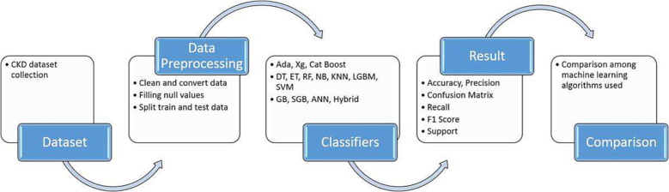
BLOCK DIAGRAM

Slide 13
TESTING
Upload dataset: The kidney disease prediction dataset is typically composed of patient data, including features like age, blood pressure, serum creatinine levels This dataset often includes both demographic information and clinical test results, which are crucial for predicting the onset and progression of Chronic Kidney Disease (CKD). The dataset is uploaded into the working environment, usually in a CSV format, allowing for analysis, preprocessing, and model training to begin.
Exploratory Data Analysis (EDA): EDA helps understand the dataset by visualizing distributions, correlations, and identifying patterns or anomalies, guiding further data processing.
Data Preprocessing: This step cleans the data by handling missing values, outliers, and normalizing or scaling features, ensuring the data is suitable for model training.

Slide 14
Feature Encoding: Categorical data is converted into numerical format using methods like one-hot encoding or label encoding, enabling machine learning models to interpret these features.
Model Building: In this step, machine learning algorithms are applied to the processed dataset to train models that can predict the target variable based on input features.
Models Comparison: Multiple models are evaluated and compared using metrics like accuracy, precision, and recall to identify the best-performing model for the given problem.

Slide 15
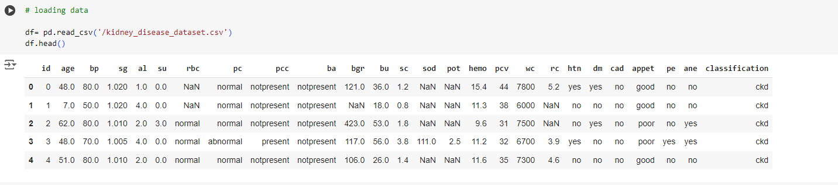
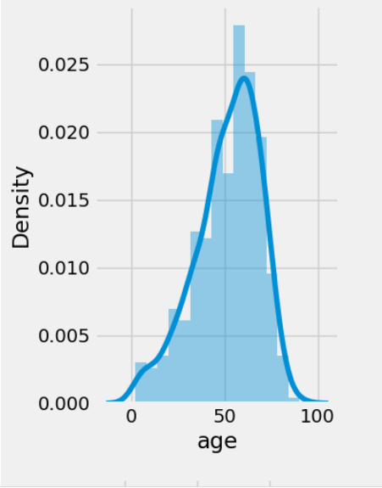
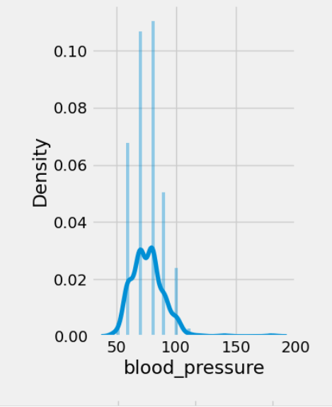
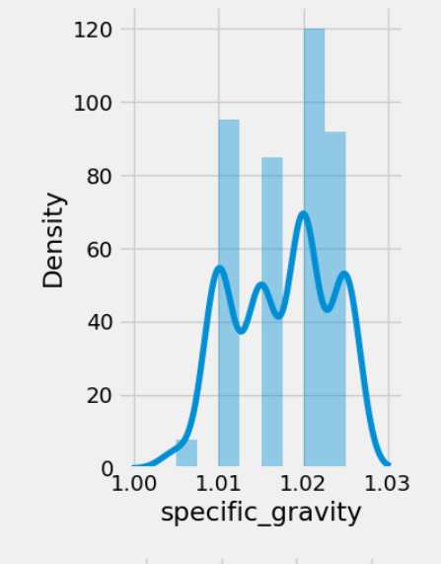
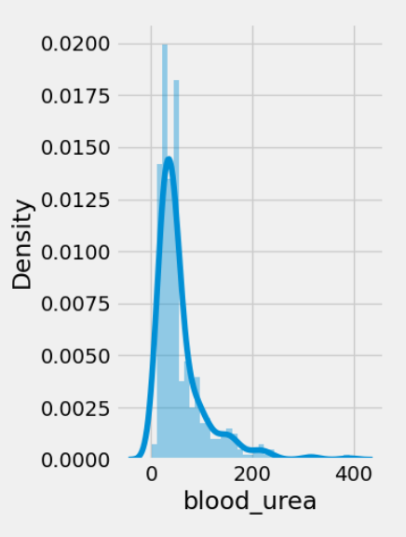
RESULTS

Slide 16
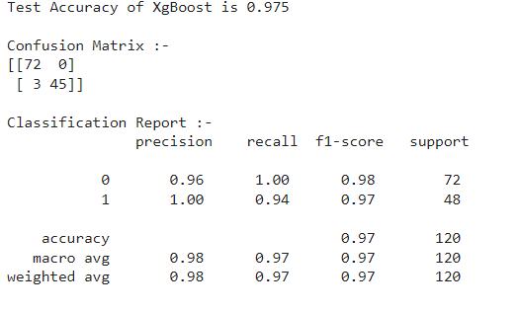
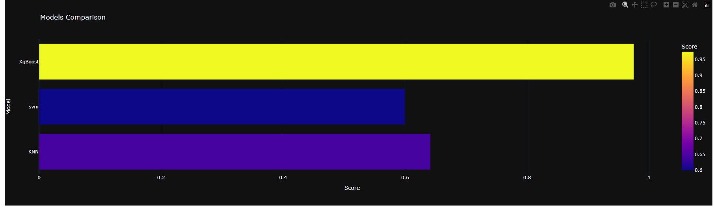
XG BOOST ALGORITHM:

Slide 17
FUTURE SCOPE
Personalized CKD Risk Assessments
Integration of Multimodal Data Sources
Predictive Analytics for Early Detection
Real-Time Data Integration Analysis
Scalability for Diverse Clinical Settings

Slide 18
REFERENCES
[1] Chamandeep Kaur 1 , M. Sunil Kumar 2 , Afsana Anjum 1 , M. B. Binda 3 , Maheswara Reddy Mallu 4 , and Mohammed Saleh Al Ansari 5,Chronic Kidney Disease Prediction Using Machine Learning
Link:https://www.jait.us/uploadfile/2023/JAIT-V14N2-384.pdf
[2] K Gaurav,A. Kumar ,P.Singh,A.Kumari.,” Human Disease Prediction using Machine Learning Techniques and real-life Parameters.”,2023 International Journal of Engineering.
Link:https://www.ije.ir/article_169090.html.
[3] Siddharwar Tikale,Pranjal Shingavi,Sukanya vandekar,” Prediction of Chronic Kidney Disease Using Machine Learning Algorithm
Link:https://www.researchgate.net/profile/Siddheshwar-Tekale/publication/329395701_Prediction_of_Chronic_Kidney_Disease_Using_Machine_Learning_Algorithm/links/629f07e3a3fe3e3df863f42e/Prediction-of-Chronic-Kidney-Disease-Using-Machine-Learning-Algorithm.pdf

Slide 19
[4].Revathy Ramesh,” Chronic Kidney Disease Prediction using Machine Learning Models”.
Link:https://www.researchgate.net/profile/Revathy-Ramesh-3/publication/341398109_Chronic_Kidney_Disease_Prediction_using_machine_Learning_Models/links/5ebe42b1458515626ca85977/Chronic-Kidney-Disease-Prediction-using-Machine-Learning-Models.pdf
[5]. Reshma , Salma Shaji , S R Ajina , Vishnu Priya , Janisha,” Chronic Kidney Disease Prediction using Machine Learning”,
Link:https://www.ijert.org/research/chronic-kidney-disease-prediction-using-machine-learning-IJERTV9IS070092.pdf

Slide 20
CONCLUSION
In this study, various machine learning algorithms were explored to diagnose Chronic Kidney Disease (CKD) at an early stage. The models were trained and validated using key patient data, and unnecessary features were removed to improve accuracy. It was found that hemoglobin, albumin, and specific gravity were the most critical factors in predicting CKD. The dataset was preprocessed, and Principal Component Analysis (PCA) was used to highlight the most important features. Among the algorithms tested, XGBoost showed the best performance, making it the most effective model for CKD prediction in the proposed system. This approach can lead to earlier diagnosis and better patient outcomes.

Slide 21
THANK YOU

